Slide 1
Expeditor
Urban Food-Supply Marketplace and Delivery Optimization System
IFT 402 Paul Polsinelli

Slide 2
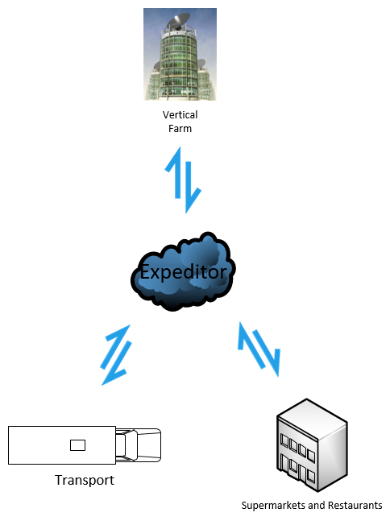
Fresh food, produced by indoor vertical farms, delivered to local markets with next to zero food waste, at minimal cost, with maximum fuel savings.
Expeditor

Slide 3

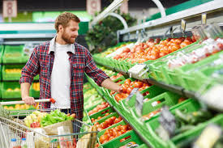
The Urban Stakeholders: Supermarkets, Restaurants, and their Customers

Slide 4
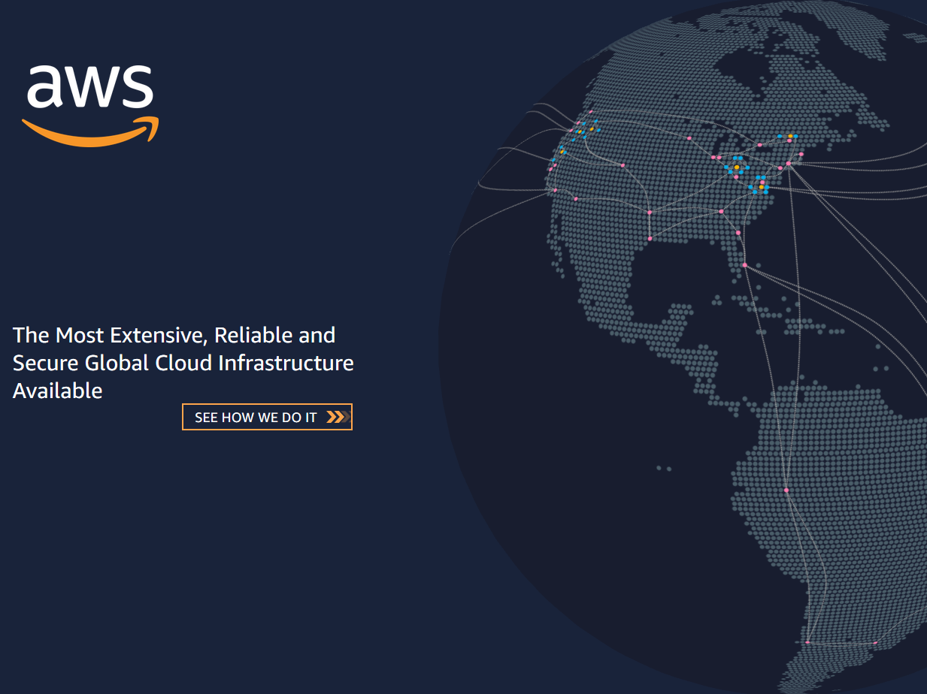
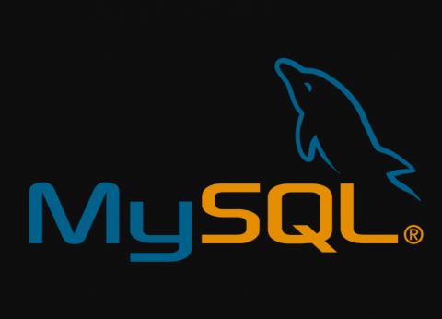

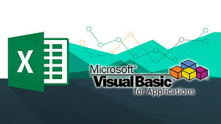






The Technology
Tensorflow
Keras
<html>
API REST framework
<CSS>
<javascript>

Slide 5
The Build
Build 2 has redesigned the database, combining all previous tables into one and adding a table for a vertical farm.
The excel distance matrix has been redesigned and streamlined, splitting the supermarket and restaurant matrices into separate sheets. Functionality has been added to order the vertical farms by distance for selection by the Expeditor script.
The Expeditor script has been added to in order to select the closest vertical farm, check its available capacity in its database table, compare it to and order, subtract the order from its capacity, and update the table with the new capacity.
The Expeditor UI has been streamlined as well by combining all previous tables. The previous rendering issue of all the tables was not solved but this workaround allowed all values to be written and displayed in one table.
Django scripts have been completely overhauled for compatibility with redesign of database

Slide 6
Accomplishments
Predictive AI script enhanced with functionality to select and update closest vertical farm
Database redesigned for efficiency and a new vertical farm entity introduced
Custom API’s completely overhauled and simplified
Supermarket and Restaurant UI updated, streamlined, and table rendering fixed
Distance matrix’s functionality enhanced, and design simplified

Slide 7

Progress

Slide 8
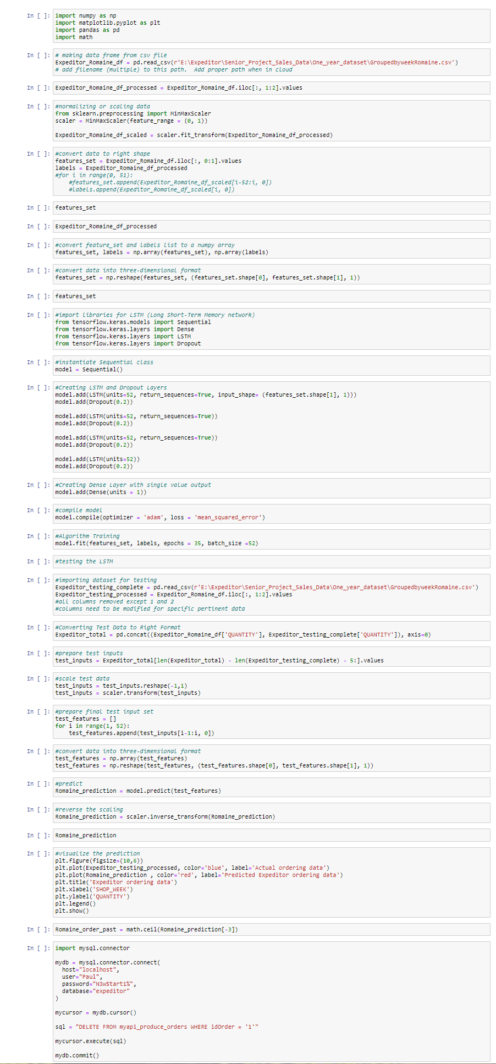
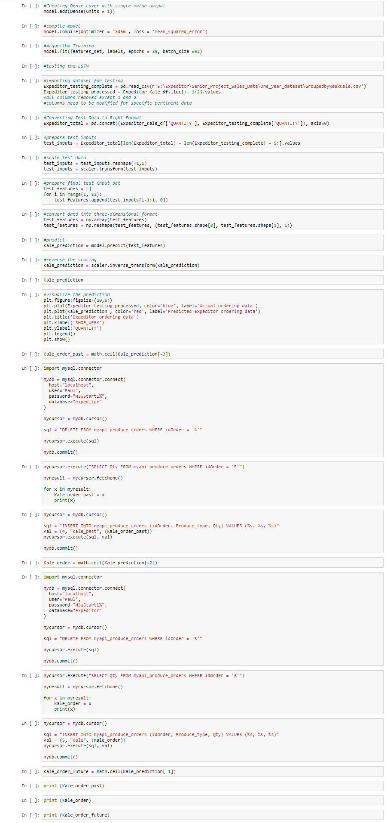
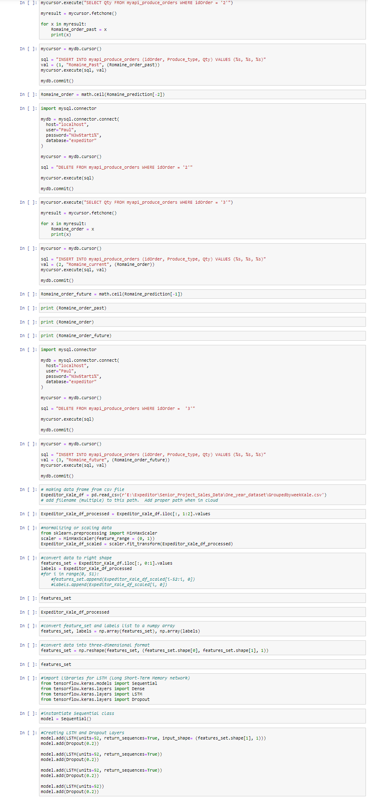
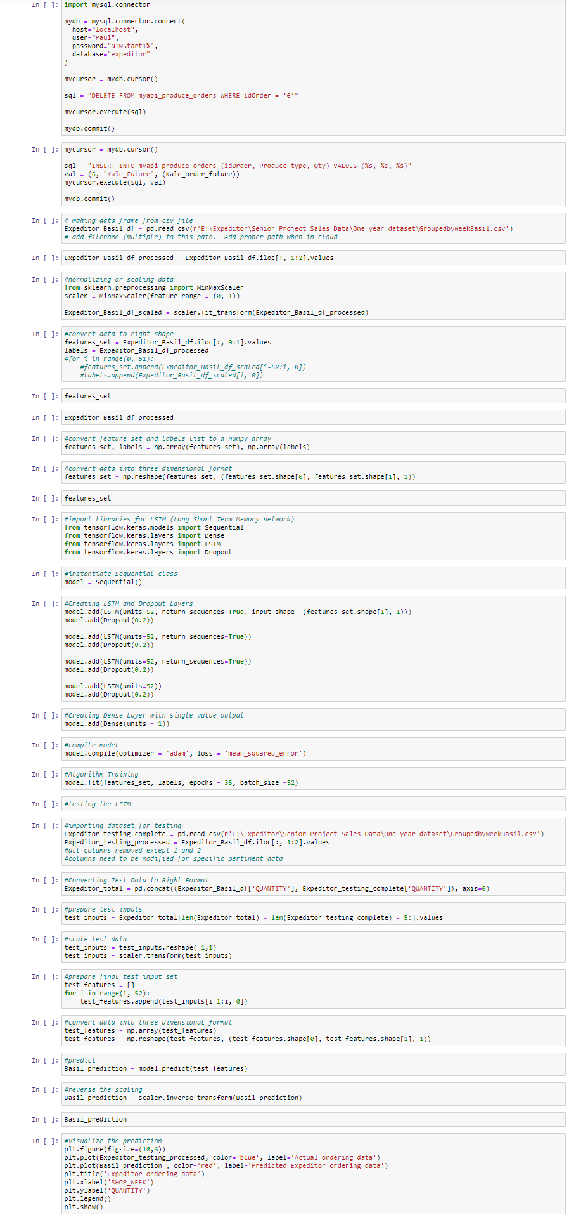
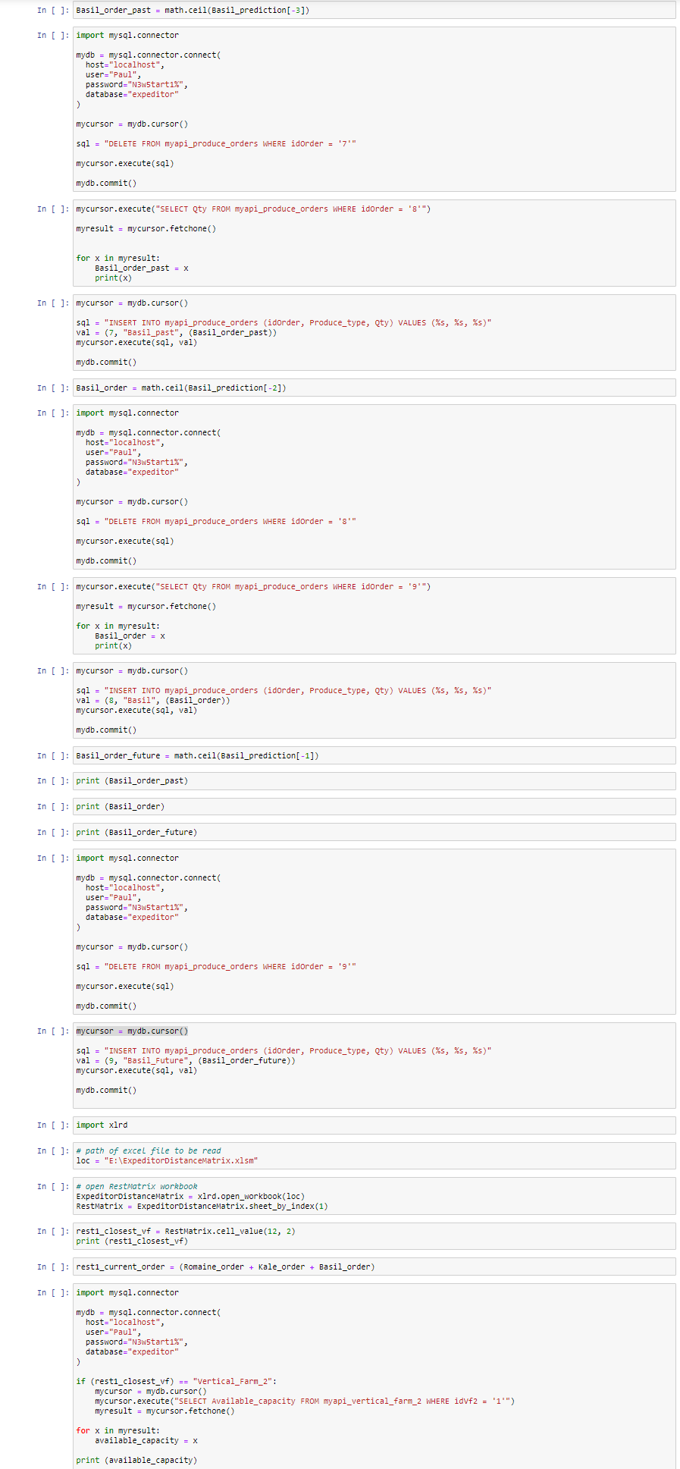
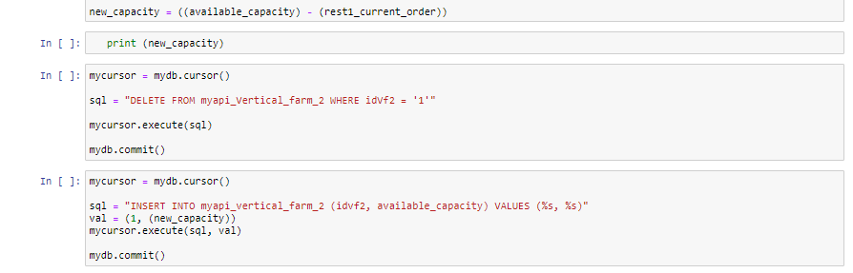
Step 1: The AI Expeditor Script
Written in Tensorflow environment in Python language with the Tensorflow and Keras libraries. Displayed in Jupyter Notebook. Uses a Long Short-Term Memory (LSTM) predictive recurrent neural network.
The script reads in an adapted 52-week sales data dunnhumby “Let’s Get Sort-of-Real” dummy supermarket sales dataset. https://www.dunnhumby.com/source-files/
For three products (Romaine, Kale, and Basil), the script interfaces with mysql, predicts a sales order quantity, writes it to the ‘future order’ rows, rewrites previous future order to ‘current order’ rows, and rewrites current order to ‘past order’ rows.

Slide 9
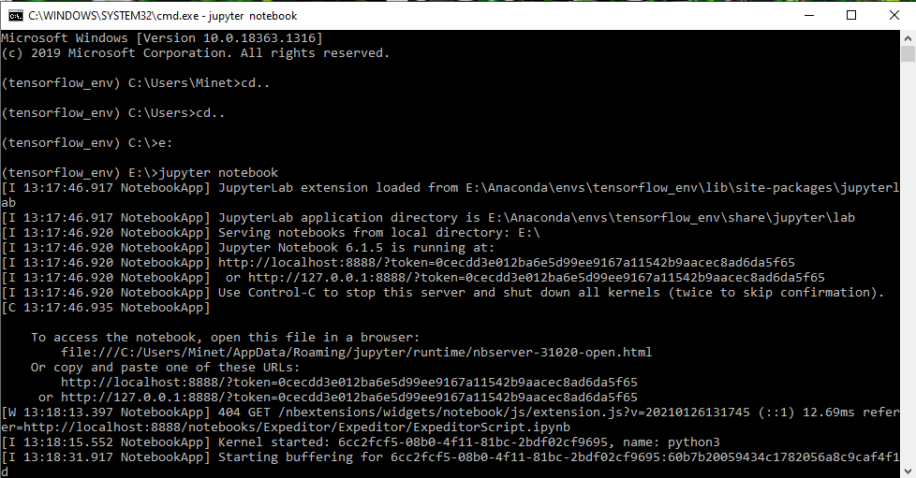
Tensorflow environment Jupyter Notebook cmd interface

Slide 10
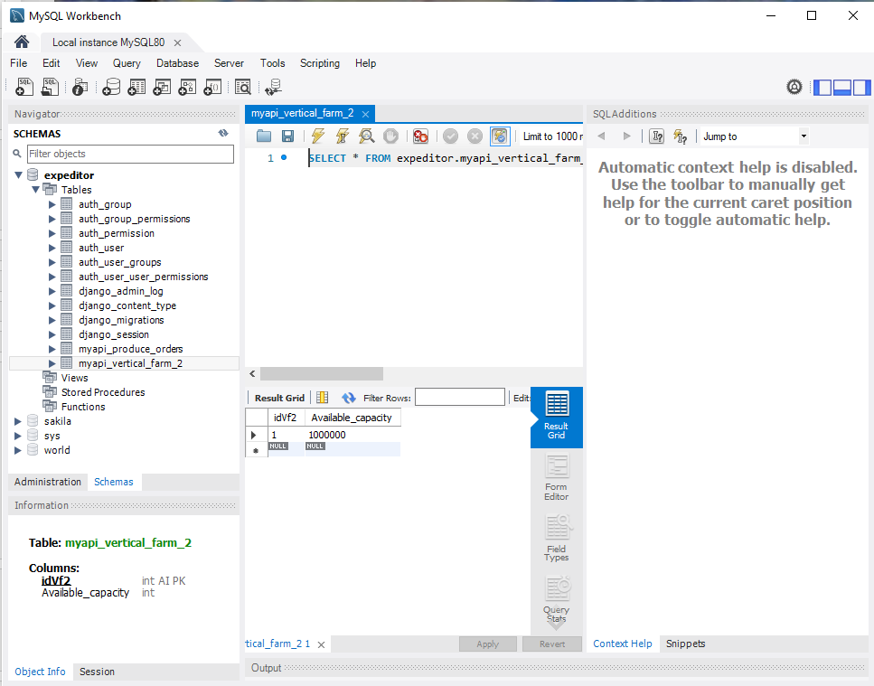
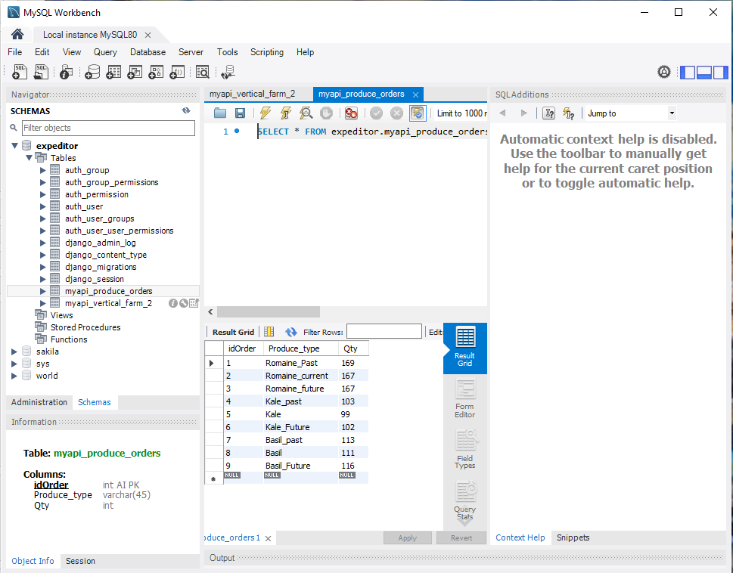
Step 2: The Expeditor Database
Interfaces with the Expeditor Script for predictive input and Django REST Framework for API transactions. Will contain more tables for Vertical Farm data and Transport data in coming builds.

Slide 11
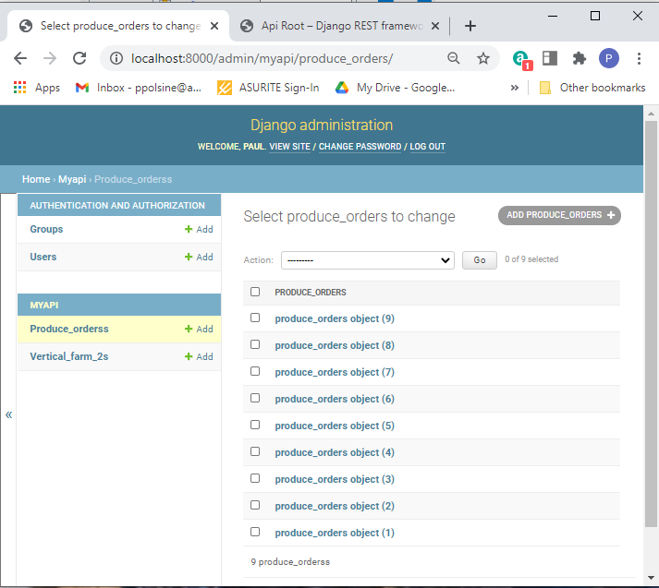
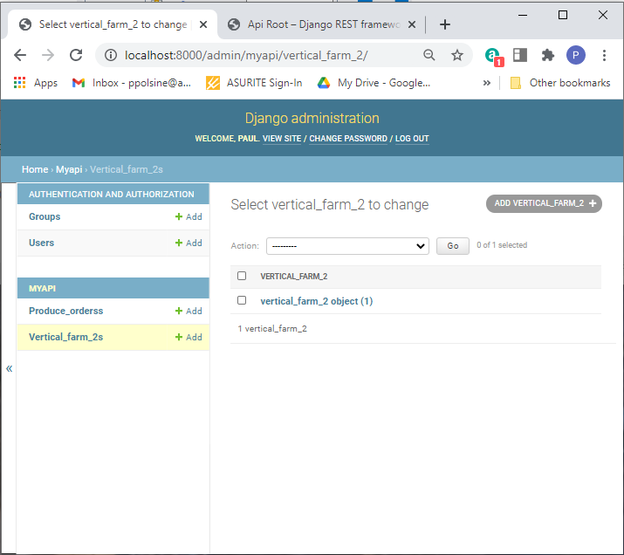
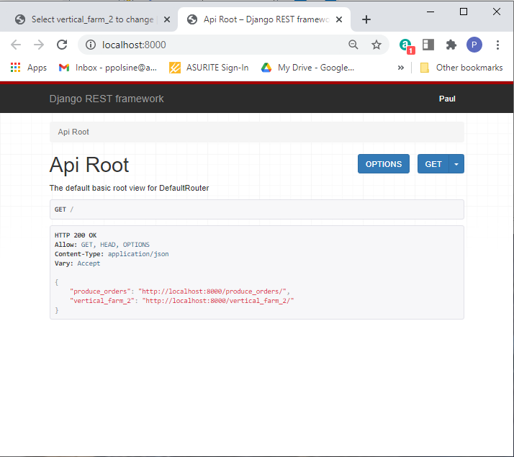
Step 3: Django Rest Framework
Interfaces with the Expeditor Database. It incorporates the Expeditor Supermarket and Restaurant User Interface within its framework and interacts with the HTML, CSS, and JS code through specialized coding interfaces.
Continued on next slide…

Slide 12
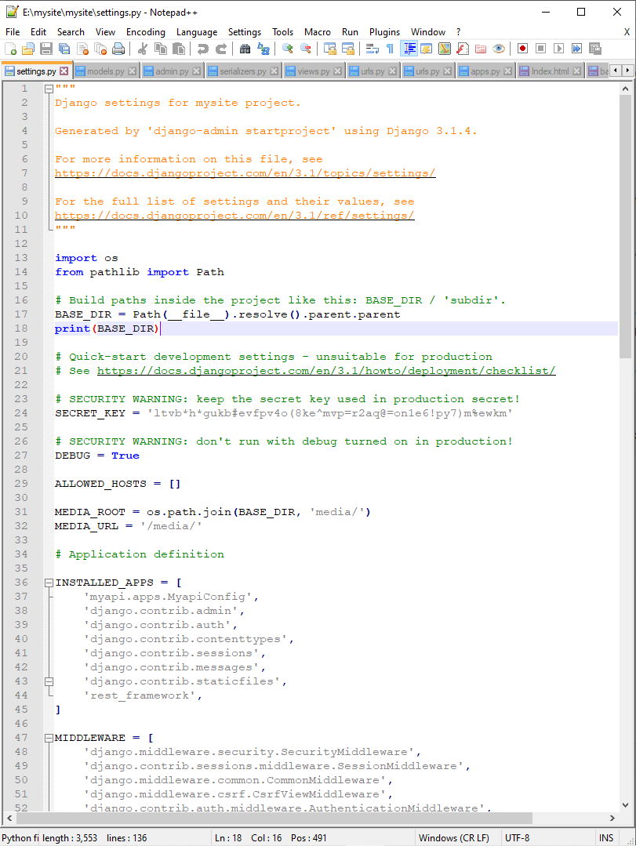
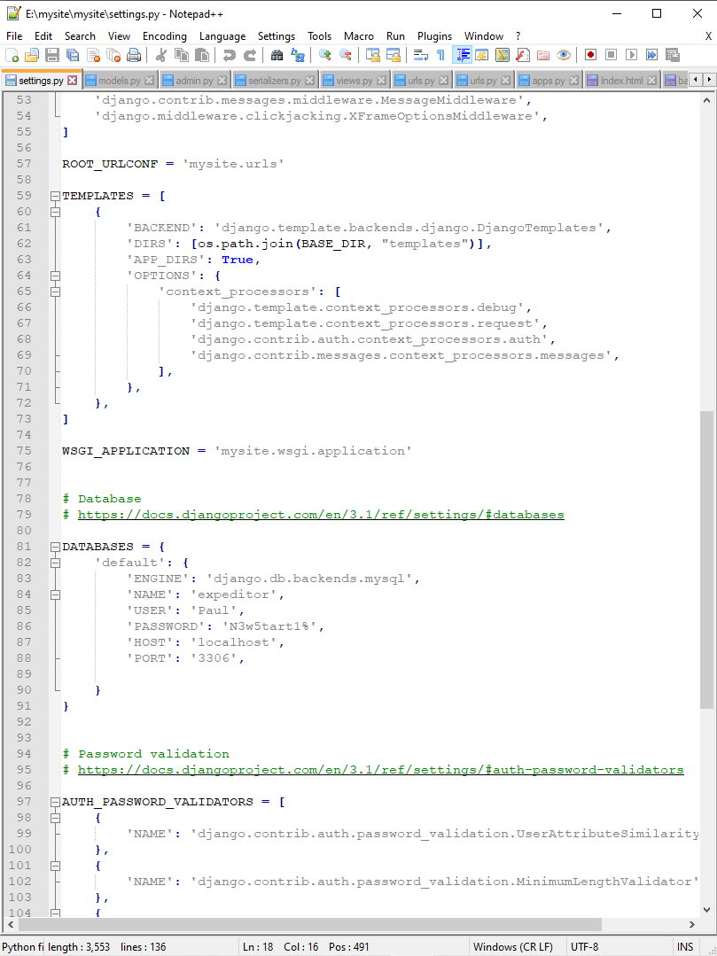
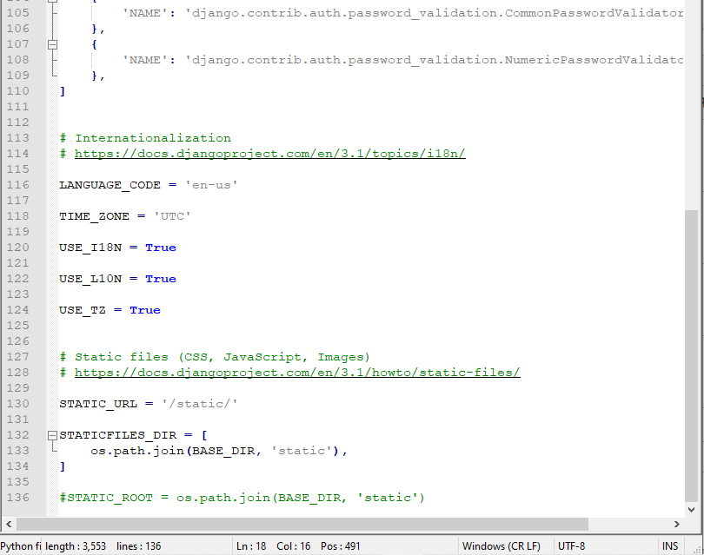
Step 3 continued: settings.py
Django settings.py file is the main file that creates the app that interfaces with the database, defines the database, connects to HTML templates, CSS, JS, and media files.

Slide 13
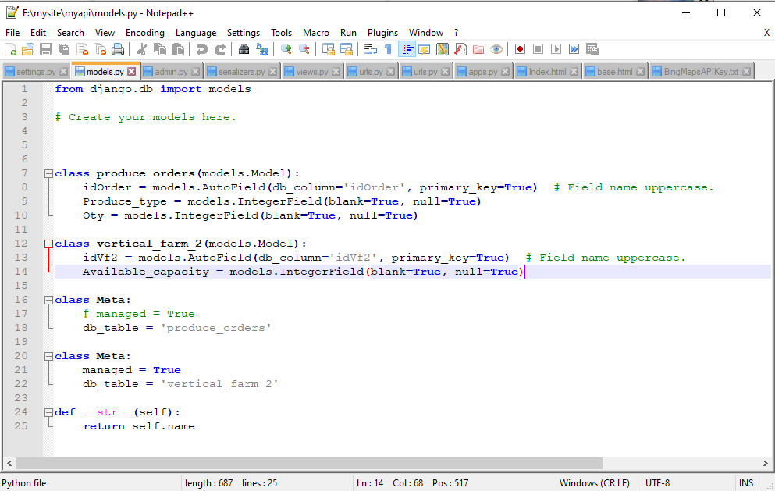
Step 3 continued: models.py
Django models.py file defines the db tables from the settings.py defined db within the Django REST Framework.

Slide 14
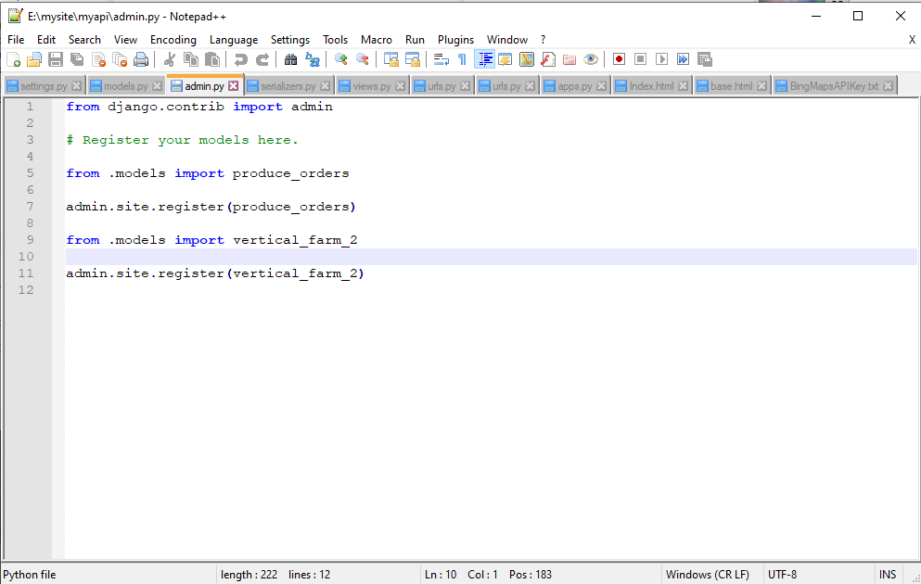
Step 3 continued: admin.py
Django admin.py registers the tables from models.py with Django administration so they may be acted upon within the framework.

Slide 15
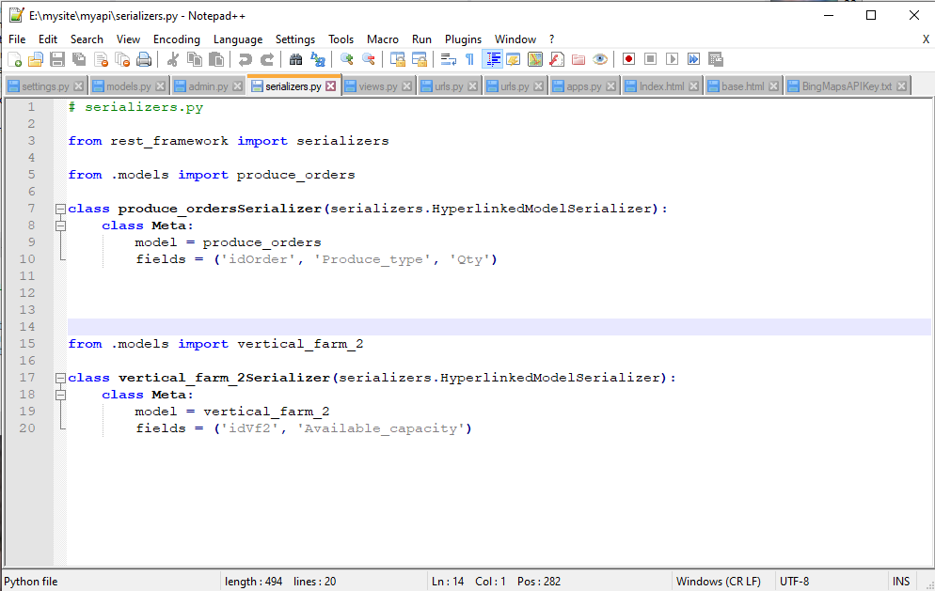
Step 3 continued: serializers.py
Django serializers.py connects and transforms the data in the tables into encapsulated json files.

Slide 16
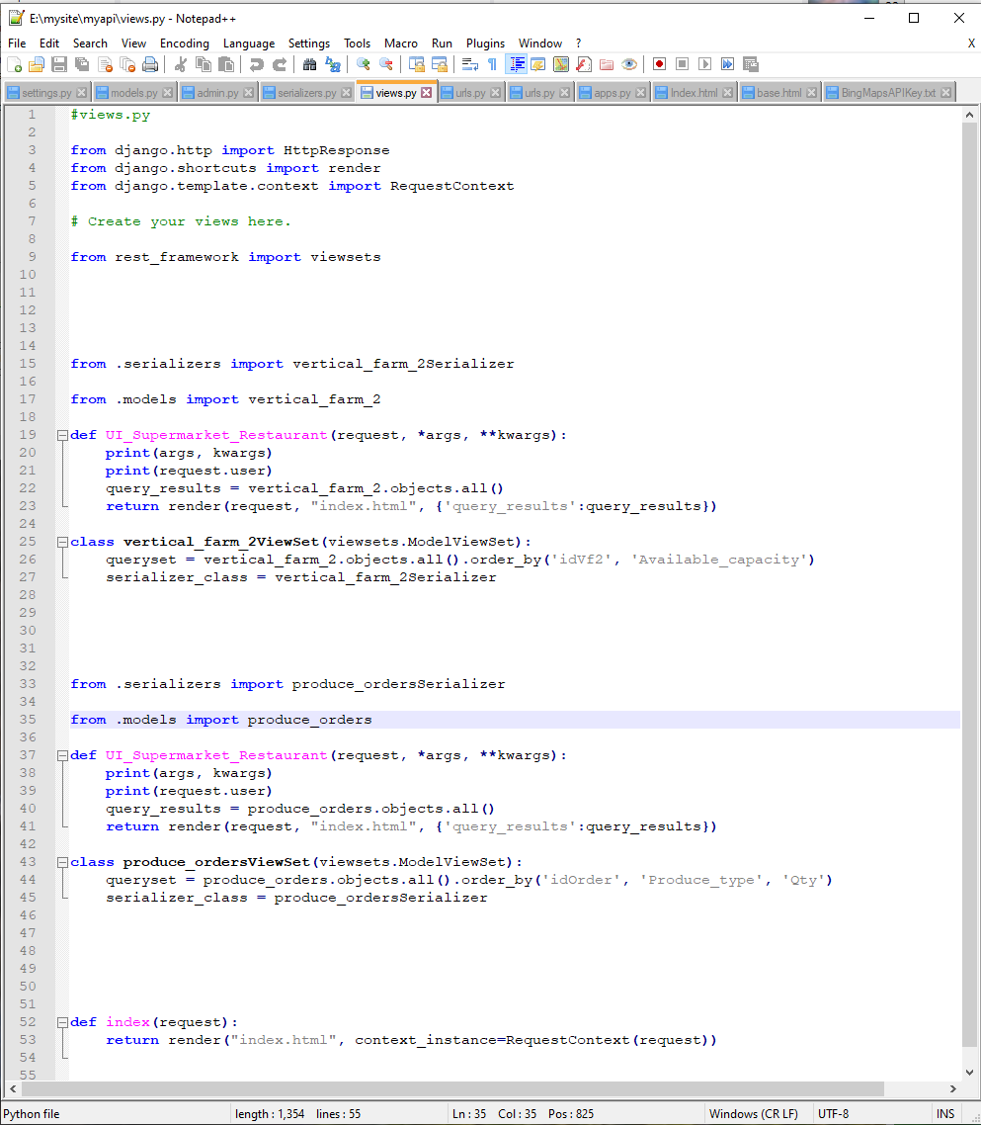
Step 3 continued: views.py
Djano views.py creates the functions that render the json data files into the UI tables.

Slide 17
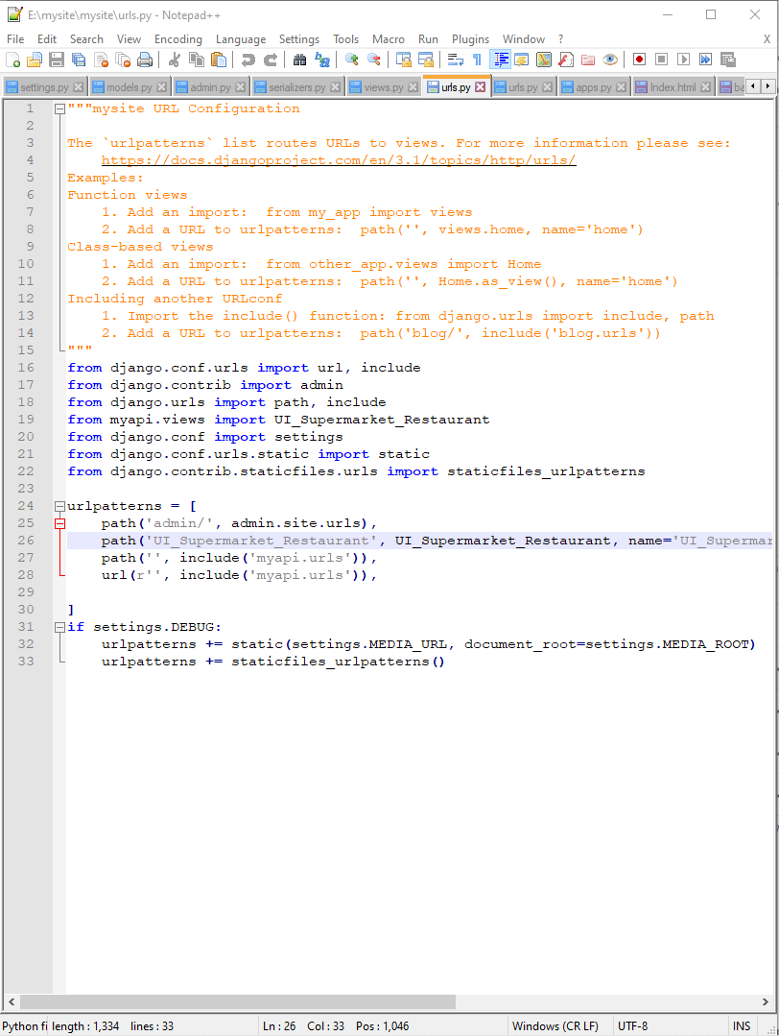
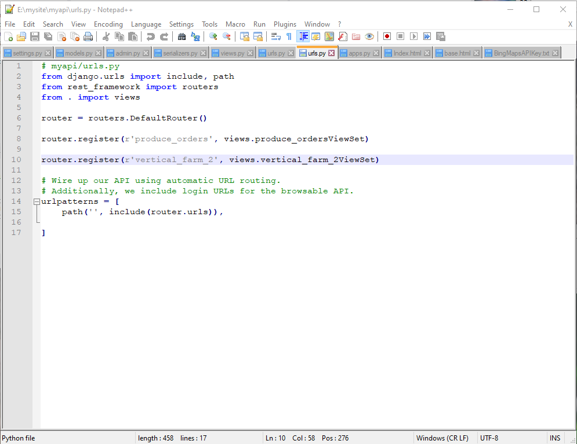
Step 3 continued: urls.py
There are two urls.py in Django REST framework that concern themselves with routing the data between the DB and the UI.

Slide 18
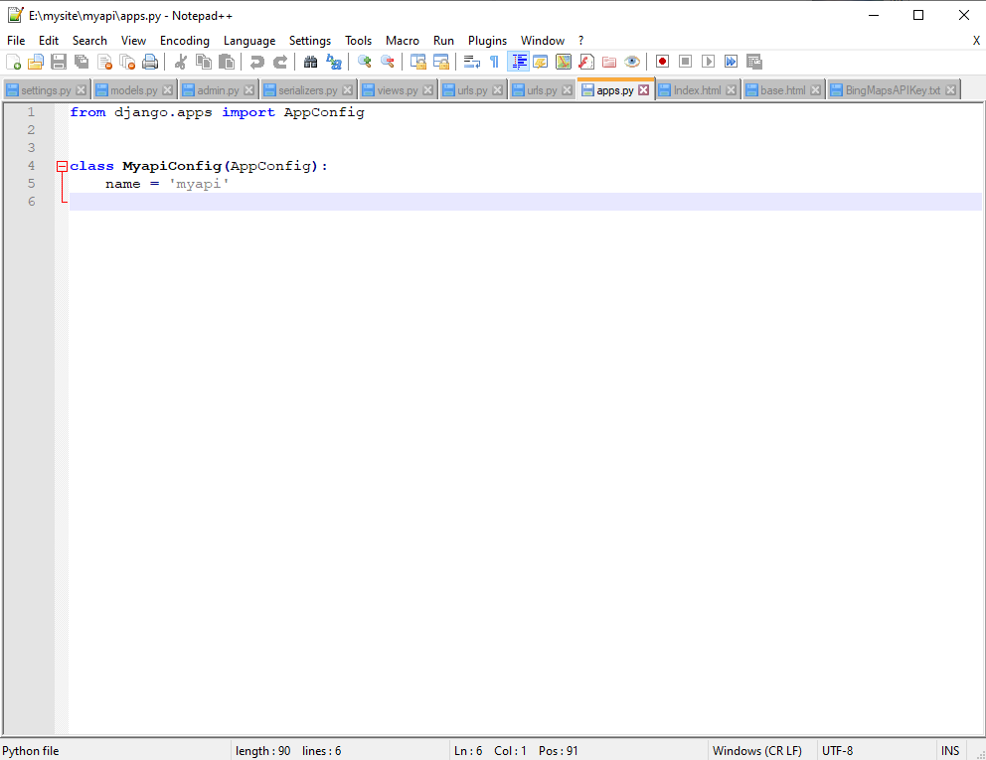
Step 3 continued: apps.py
Django apps.py holds the information about the apps created by settings.py.

Slide 19
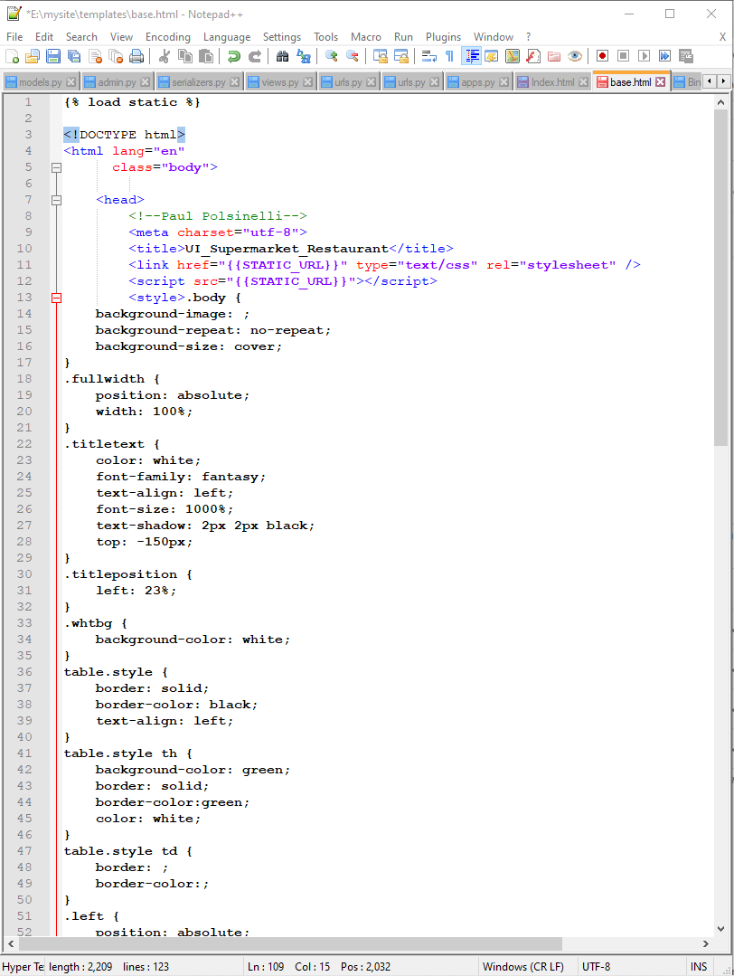
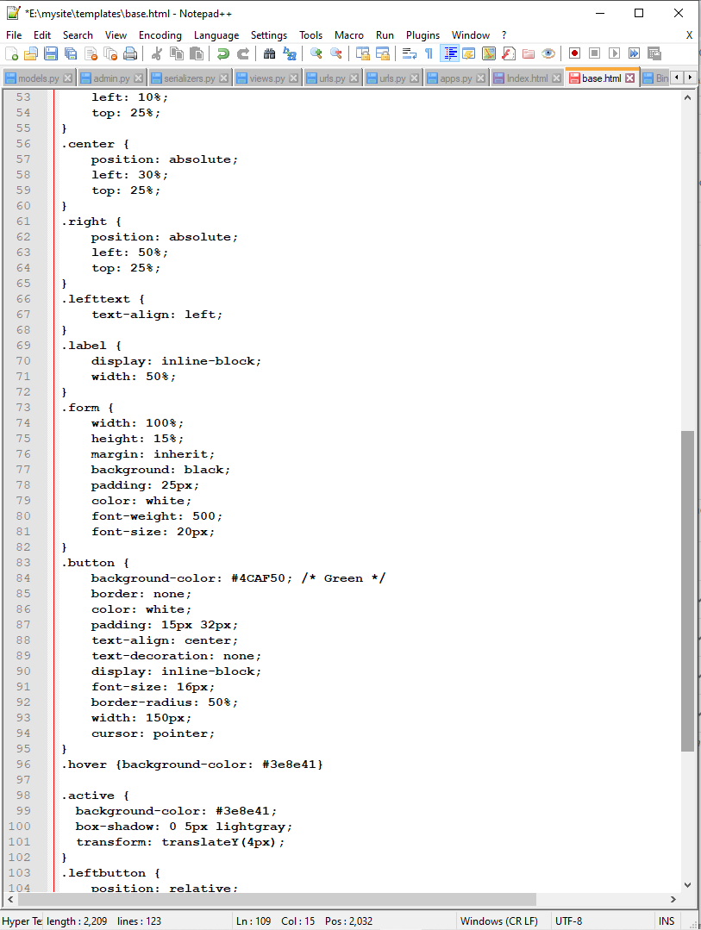
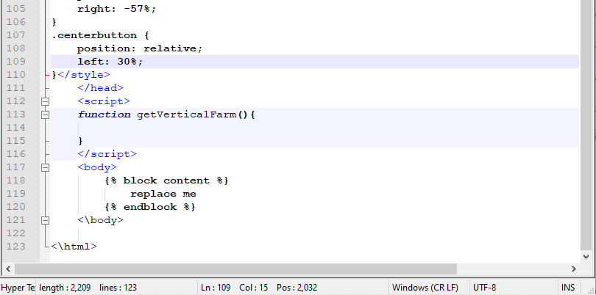
Step 3 continued: base.html
The main HTML file within the Django framework that holds the metadata and contains the connective code to the body and static files.

Slide 20
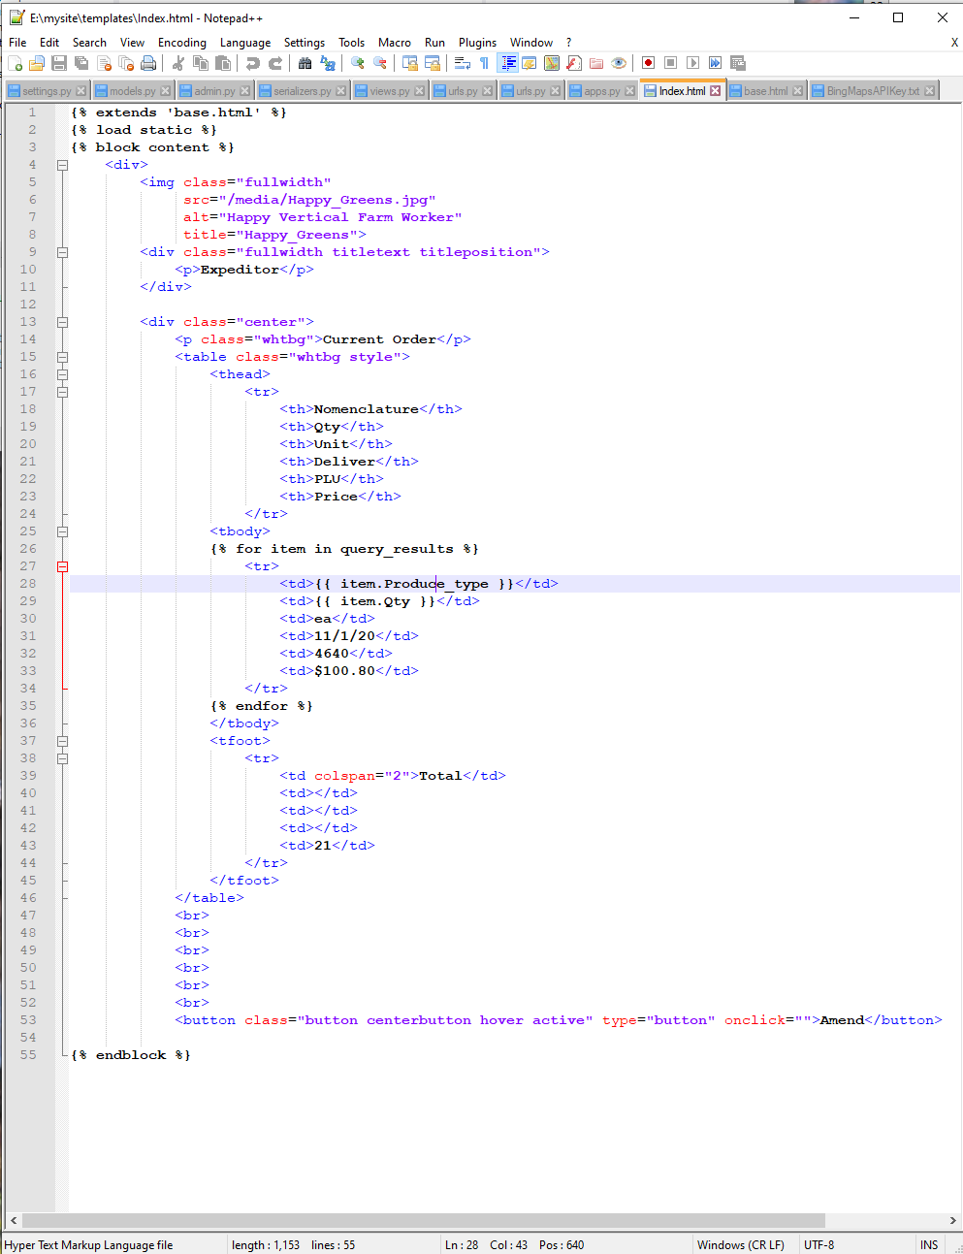
Step 3 continued: Index.html
The Django file that holds the body of the html code and connects to base.html.

Slide 21
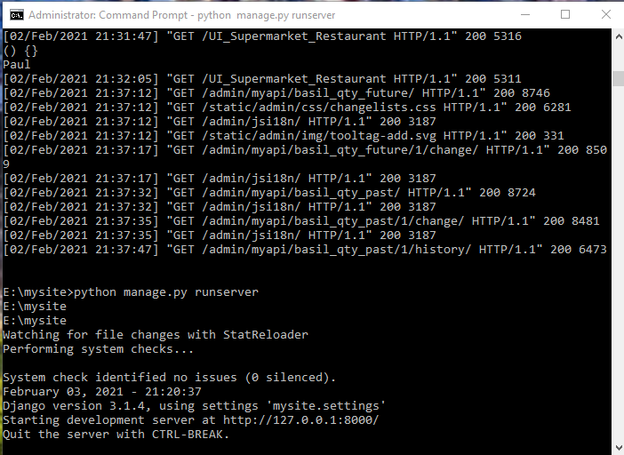
Django server cmd interface

Slide 22
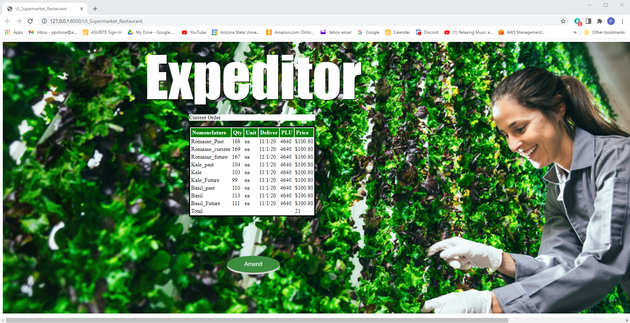
Step 4: Supermarket and Resturant UI

Slide 23
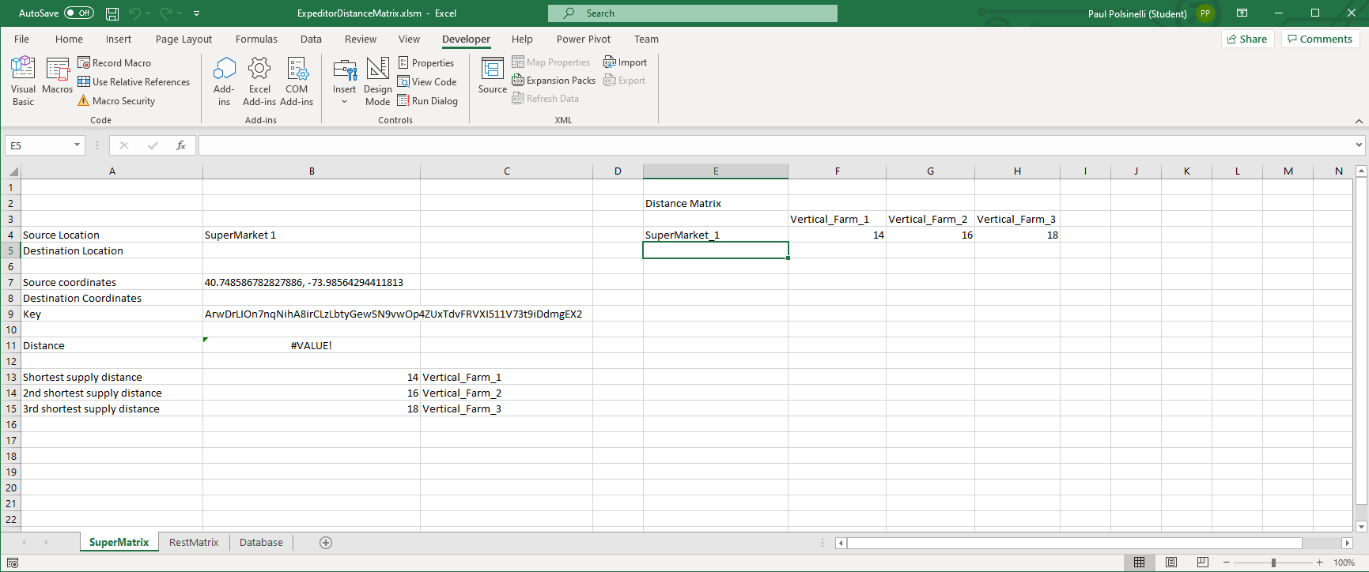
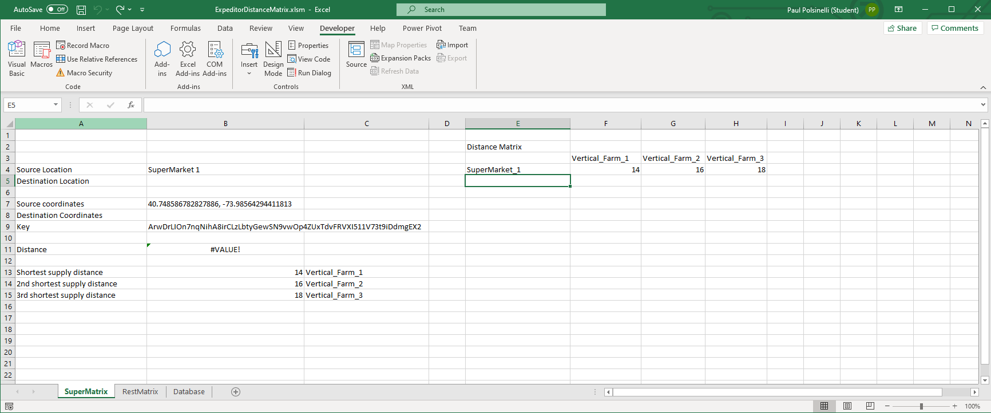
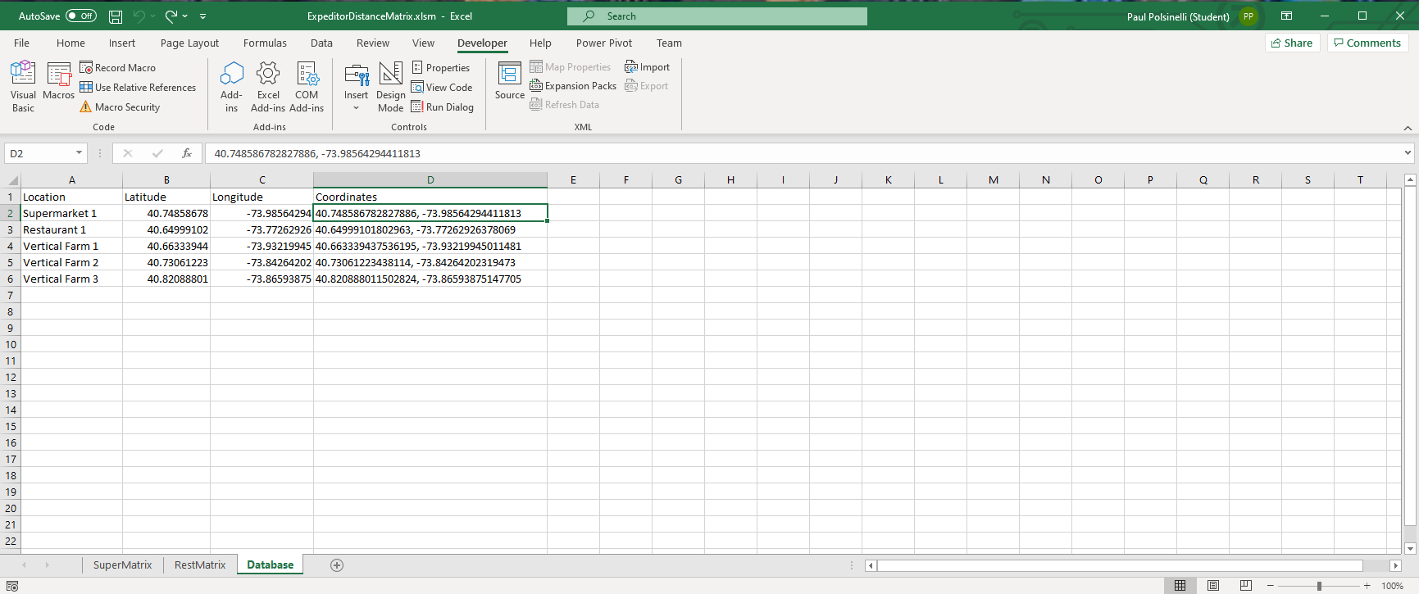
Step 5: Distance Matrix
Calculates the distance between the producers and suppliers

Slide 24
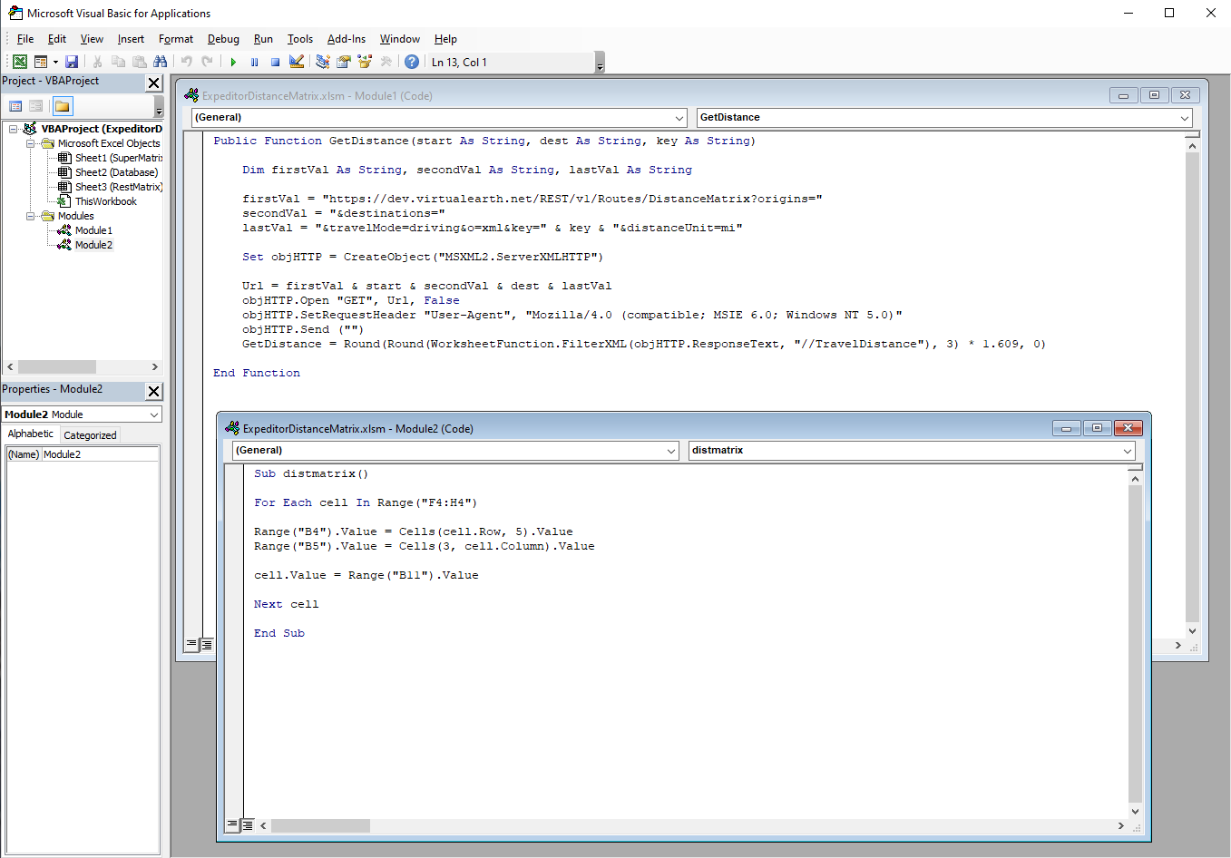
Visual Basic for Applications code for distance matrix
Code to utilize the Bing Maps API and to populate the distance matrices

Slide 25

Problems

Slide 26
Fixed Issues
The biggest issue taken care of was getting the table to render all the data in the UI. I did a work around after absolutely exhausting all possible avenues to fix the problem as is, even posting the problem in stack overflow which did not receive a response yet. I did, however, identify the issue in part. The query call only renders the last model in the models.py page. I tried many ways to differentiate the queries without luck and this may present itself as a problem again in the future, but for now, with everything on one table as it should have been originally in hindsight, the problem is fixed.
While writing the new python code I was stuck for a while on a ‘weakly…’ I forget exactly, but it wouldn’t fetch the value from a table. And I also kept getting an ‘unread…’ error that kept fetching a null value. Those took more time than it should have to fix.
The matrices were giving me values of distances of objects to themselves which made it harder to select and order them. Eventually, I solved this but splitting one matrix into two without customer objects finding distances to themselves or other customers and only to suppliers. I had to alter the vb code a bit and learn some new excel skills but now it computes, orders, and identifies vertical farm distances for the Expeditor script to use.

Slide 27

Outstanding Issues
There are no current outstanding issues unresolved in this current build. There will be more functionality added and scaling in the next build, but everything built currently works without flaw.

Slide 28

What’s next?
Build 3 will see more tables added and scale increased as more customers and suppliers are added and transportation is introduced
A transportation selection process will be introduced
Confirmation functionality will be added, probably in the form of emails to customer and Boolean rows in databases
The UI’s design will be improved so that the table reads clearer, and an amend functionality will be added

